Slide 1


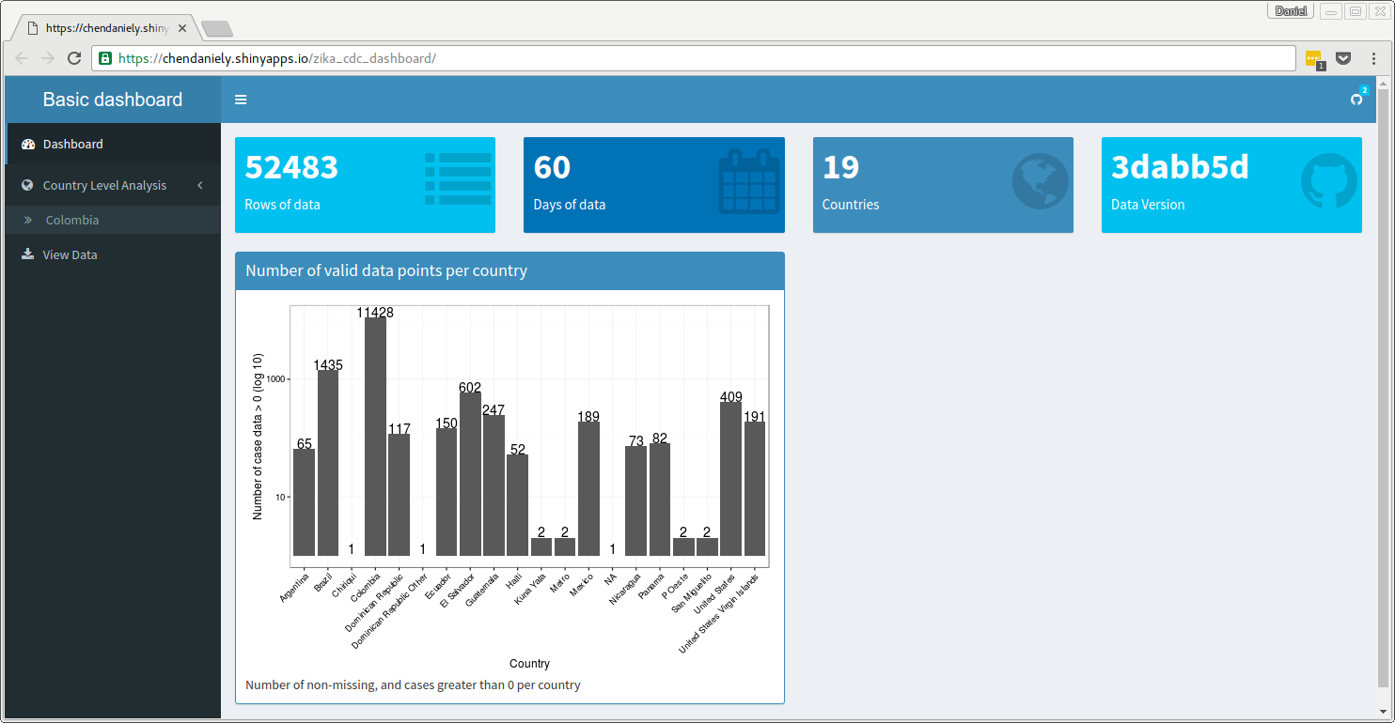
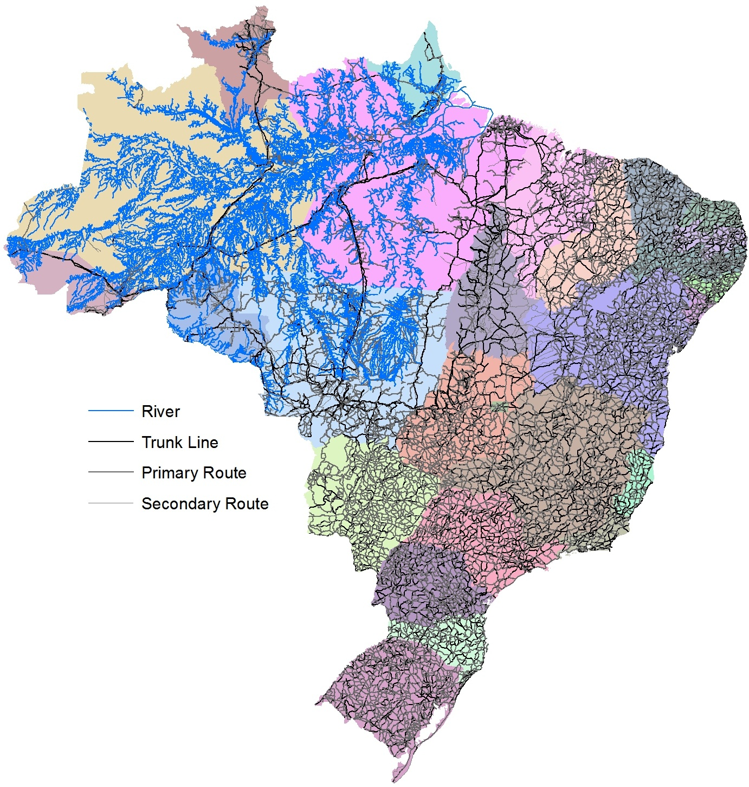
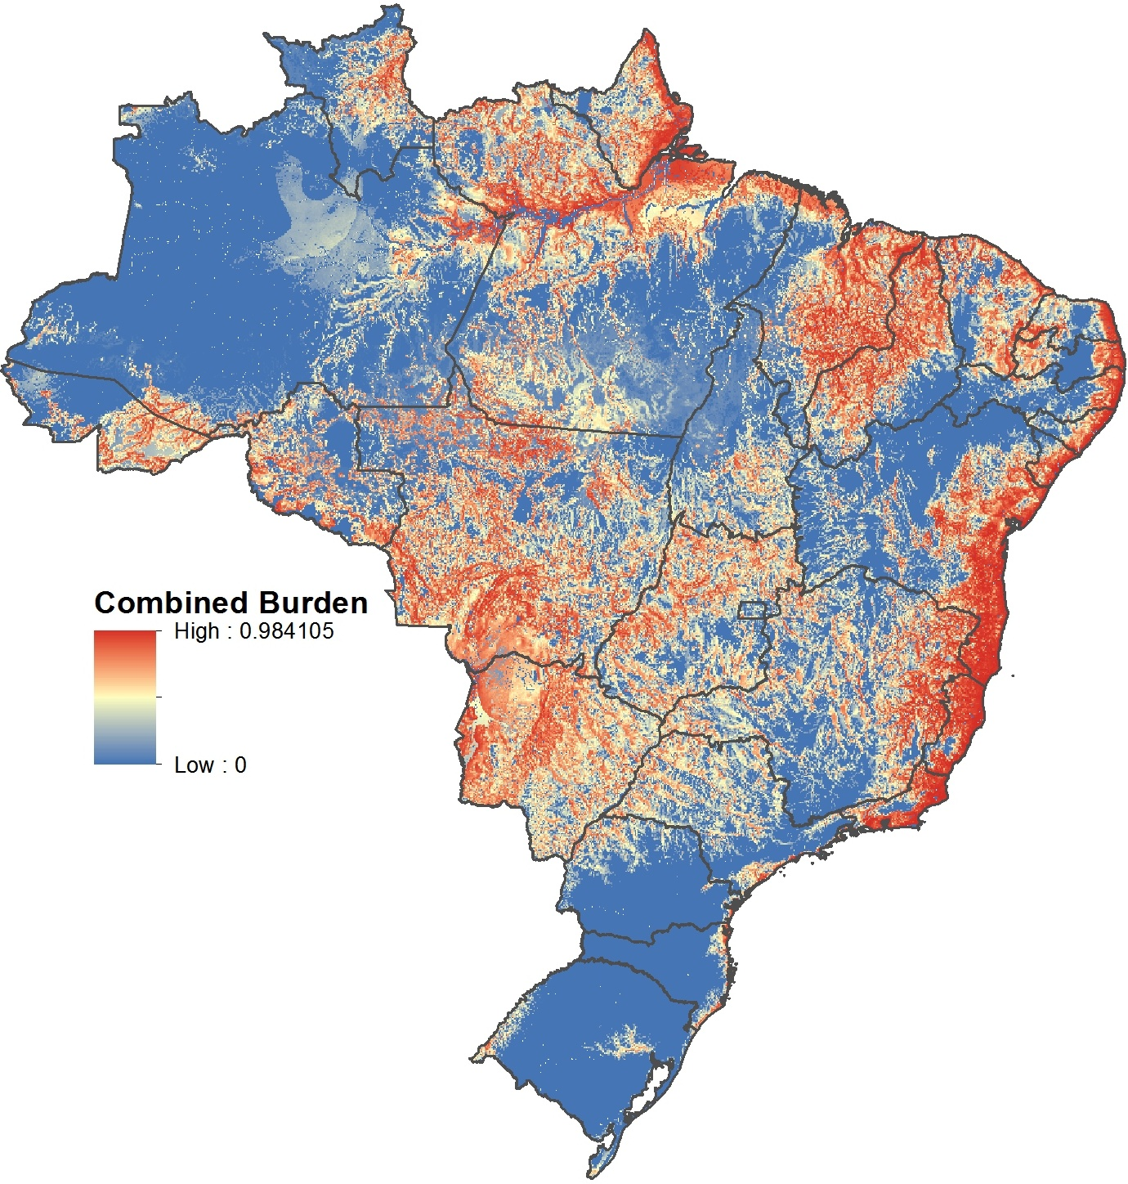
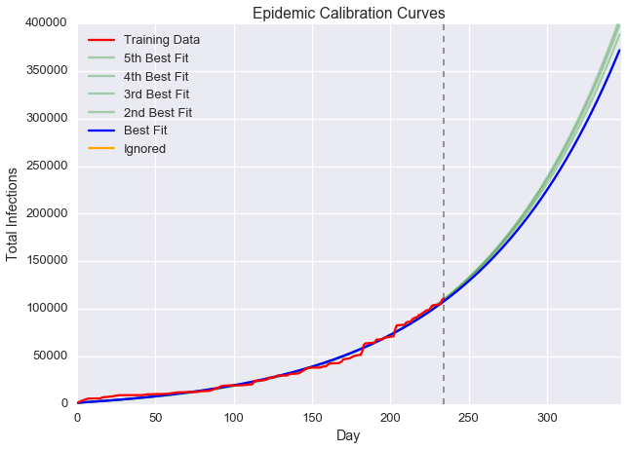
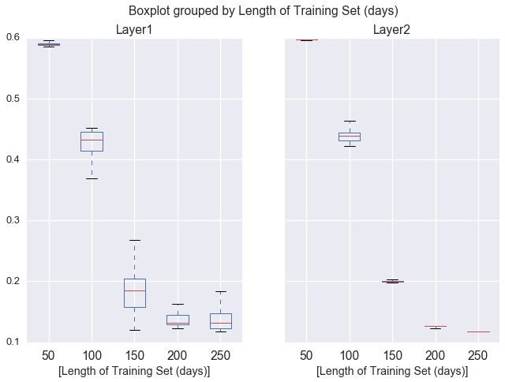
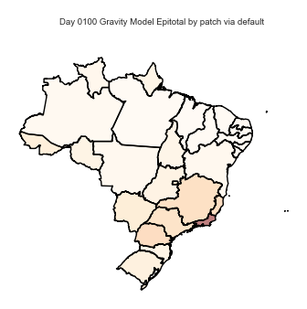
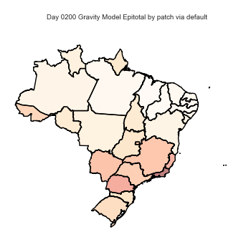
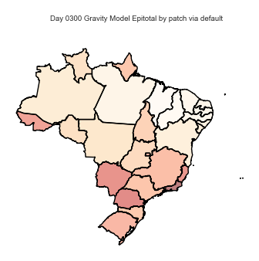

Adaptive Zika Virus Modeling with EpiGrind
James Schlitt, Pyrros A. Telionis, Daniel Chen, Bryan Lewis, & Stephen Eubank
Genetics, Bioinformatics and Computational Biology
Biocomplexity Institute of Virginia Tech
Motivation
EpiGrind was developed to provide an open source solution to explore community-provided disease transmission models and to model the spread novel illness through geographic, metapopulation patch models.
Simulated Annealing Algorithm
EpiGrind uses python metaprogramming to insert functions of experimental variables into a base model for simulation execution and evaluation. These experimental variables are then iteratively searched over via a biologically inspired simulated annealing algorithm until candidate solutions are found that accurately predict the course of an epidemic.
With EpiGrind, one may use an existing disease transmission model as a a starting point to create novel models for emerging illnesses which better fit the available case data.
*Dengue and Chikungunya Model Parameters taken from “A network-patch methodology for adapting agent-based models for directly transmitted disease to mosquito-borne disease” (Manore et al., 2015).
Results
Using data from June 23rd, 2015 to February 12th, 2016 and projecting 12 weeks into the future, we predict 274,323 cases in Brazil by May 6th, 2016 and 371,660 cases by June 3rd. The calibrated Zika model suggested a significantly longer human to mosquito infectious stage than seen in Manore et al’s Dengue and Chikungunya models as well as in increased mosquito death rate.
Analysis of model accuracy vs. length of training set showed that 2 stage optimization runs were not necessarily more accurate than single stage runs and that reasonable predictions could be made using roughly 2/3rds of the calibration curve.
Comparison to Dengue models suggested a 1.34% detection rate of Zika infection in Brazil with only 6.74% of symptomatic cases receiving laboratory confirmation.
Conclusion
During this project we constructed and deployed a powerful, open source tool chain, allowing us to predict the course of an outbreak and allowing the community to directly build upon our efforts. We have provided a sound rallying point for those with additional talents beyond our own via open data and open code
Motivation
A travel network and exposure map were needed in order to describe the rates of localized exposure of susceptible humans to infected mosquitos and the degree to which human travel drove the spatiotemporal spread of Zika.
Gravity Model Travel Network
The travel network was stitched together with data from OpenStreetMap, the ADC World Map Digital Atlas, and a hydrographic network of the Amazon river and her tributaries from SO-HYBAM. The latter is necessary because many parts of the rain forest are not accessible by road.
We then found population weighted centroids for each patch, calculated the network travel time between them, and fit to these data a generalized non-linear Poisson model trained on known bus transit figures from the Brazilian National Land Travel Agency.
Ecological Niche Model Exposure Mapping
To estimate the number of individuals in each patch bitten by mosquitoes we combined environmental niche models of Aedes albopictus and Aedes aegypti, then overlaid the output with population data from LandScan 2014. This is significant to the transmission dynamic because urban areas are not always inundated with mosquitoes.
Spatial Simulation Results
The gravity model was used to project the dispersal of human infection for an epidemic using the calibrated transmission model parameters across the 27 states of Brazil.
Conclusion
The gravity model emergence sequence closely followed that predicted by bus travel models and was able to account for remote regions with limited or no established roads. Future work will apply EpiGrind’s self optimization to explore the seasonal effects of mosquito density and to calibrate the model’s emergence sequence to real world data.
Motivation
Following the example set by Dr. Caitlin Rivers during the 2014 West Africa Ebola epidemic, we are working with the CDC to centralize access to epidemiological data via a public download and visualization portal. In doing so, we seek to reduce barriers to entry and better coordinate outbreak response efforts.
https://chendaniely.shinyapps.io/zika_cdc_dashboard
Methods
The dashboard was designed to further facilitate access to data gathered through a CDC led effort to crowd source the digitization of the many Ministries of Health provided data (often provided in PDF form). The dashboard consolidates the data on the GitHub repository: github.com/cdcepi/zika. The dashboard combines 100s of individual files and provides summary statistics (frequencies and time series) across the natural groupings of the available data (count type, geographic area, dates, etc.). A central ”Download” button is provided to facilitate the sharing of this data.
Results
A public, open data portal was created allowing users to visualize, spot check, and download the cleaned data stored within the CDC and Buzzfeed repositories.
Self Optimizing Transmission Models
Geographic Methods
Open Data Outreach
Model | v_{h} | γ_{h} | β_{hv} | β_{vh} | σ_{v} | μ_{v}
Dengue - Aedes Aegypti * | 0.200 | 0.167 | 0.330 | 0.330 | 0.500 | 0.0714
Chikungunya - Aedes Aegypti * | 0.333 | 0.167 | 0.240 | 0.240 | 0.500 | 0.0476
Zika Calibrated | 0.209 | 0.0902 | 0.330 | 0.218 | 0.478 | 0.113
Sources
Calvet, G., Aguiarv, R. S., Melo, A. S., Sampaio, S. A., de Filippis, I., Fabri, A., … de Filippis, A. M. (2016). Case Report of detection of Zika virus genome in amniotic fluid of affected fetuses: association with microcephaly outbreak in Brazil. Lancet Infectious Diseases, 3099(16), In press. doi:10.1017/CBO9781107415324.004
Campbell, L. P., Luther, C., Moo-Llanes, D., Ramsey, J. M., Danis-Lozano, R., & Peterson, A. T. (2015). Climate change influences on global distributions of dengue and chikungunya virus vectors. Philosophical Transactions of the Royal Society of London B: Biological Sciences, 370(1665), 20140135.
Chen, D. (2016a). Converting various datasets to adhere to CDC Zika format. GitHub Repository. Retrieved from https://github.com/ndssl/zika_data_to_cdc
Chen, D. (2016b). Shiny Dashboard for CDC Zika data. GitHub Repository. Retrieved from https://github.com/chendaniely/zika_dashboard_cdc
Dick, G. W. A., Kitchen, S. F., & Haddow, A. J. (1952). Zika virus (I). Isolations and serological specificity. Transactions of the Royal Society of Tropical Medicine and Hygiene, 46(5), 509–520.
Dornak, L., & Foley, D. (2011). Model: Aedes albopictus_Dornak_1. VectorMap. Retrieved from http://vectormap.si.edu/dataportal.htm
Duffy, M. R., Chen, T.-H., Hancock, W. T., Powers, A. M., Kool, J. L., Lanciotti, R. S., … Hayes, E. B. (2009). Zika virus outbreak on Yap Island, Federated States of Micronesia. The New England Journal of Medicine, 360(24), 2536–2543.
Foy, B. D., Kobylinski, K. C., Foy, J. L. C., Blitvich, B. J., da Rosa, A. T., Haddow, A. D., … Tesh, R. B. (2011). Probable Non-Vector-borne Transmission of Zika Virus, Colorado, USA. Emerging Infectious Diseases, 17(5), 880–882.
Haddow, A. J., Williams, M. C., Woodall, J. P., Simpson, D. I., & Goma, L. K. (1964). Twelve Isolations of Zika Virus From Aedes (Stegomyia) Africanus (Theobald) Taken in and Above a Uganda Forest. Bulletin of the World Health Organization, 31(1961), 57–69.
Hayes, E. B., & Gubler, D. J. (2006). West Nile virus: Epidemiology and clinical features of an emerging epidemic in the United States. Annu. Rev. Med., 57, 181–194.
Henderson, L. F. (1974). On the fluid mechanics of human crowd motion. Transportation Research, 8(6), 509–515.
Kuno, G., Chang, G., Tsuchiya, K., Karabatsos, N., & Cropp, C. (1998). Phylogeny of the genus Flavivirus. Journal of Virology, 72(1), 73–83.
Manore, C. A., Hickmann, K. S., Hyman, J. M., Foppa, I. M., Davis, J. K., Wesson, D. M., & Mores, C. N. (2015). A network-patch methodology for adapting agent-based models for directly transmitted disease to mosquito-borne disease. Journal of Biological Dynamics, 9(1), 52–72.
Marchette, N. J., Garcia, R., & Rudnick, A. (1969). Isolation of Zika virus from Aedes aegypti mosquitoes in Malaysia. The American Journal of Tropical Medicine and Hygiene, 18(3), 411–5.
Mlakar, J., Korva, M., Tul, N., Popović, M., Poljšak-Prijatelj, M., Mraz, J., … Avšič Županc, T. (2016). Zika Virus Associated with Microcephaly. New England Journal of Medicine, 160210140106006. doi:10.1056/NEJMoa1600651
Musso, D., Nilles, E. J., & Cao-Lormeau, V. M. (2014). Rapid spread of emerging Zika virus in the Pacific area. Clinical Microbiology and Infection, 20(10), 1–5.
Musso, D., Roche, C., Robin, E., Nhan, T., Teissier, A., & Cao-Lormeau, V.-M. (2015). Potential sexual transmission of Zika virus. Emerging Infectious Diseases, 21(2), 359.
O’Leary, D. R., Kuhn, S., Kniss, K. L., Hinckley, A. F., Rasmussen, S. A., Pape, W. J., … others. (2006). Birth outcomes following West Nile Virus infection of pregnant women in the United States: 2003-2004. Pediatrics, 117(3), e537–e545.
Oliveira Melo, A. S., Malinger, G., Ximenes, R., Szejnfeld, P. O., Alves Sampaio, S., & Bispo de Filippis, A. M. (2016). Zika virus intrauterine infection causes fetal brain abnormality and microcephaly: tip of the iceberg? Ultrasound in Obstetrics & Gynecology, 47(1), 6–7.
Paupy, C., Delatte, H., Bagny, L., Corbel, V., & Fontenille, D. (2009). Aedes albopictus, an arbovirus vector: From the darkness to the light. Microbes and Infection / Institut Pasteur, 11(14-15), 1177–85.
Petersen, E. E. (2016). Interim guidelines for pregnant women during a Zika virus outbreak—United States, 2016. MMWR. Morbidity and Mortality Weekly Report, 65.
Restrepo, M., Munoz, N., Day, N., Parra, J. E., Hernandez, C., Blettner, M., & Giraldo, A. (1990). Birth defects among children born to a population occupationally exposed to pesticides in Colombia. Scandinavian Journal of Work, Environment & Health, 239–246.
Rodrigue, J.-P., Comtois, C., & Slack, B. (2013). The geography of transport systems. Routledge.
Rodriguez, D. M., Mier-y-Teran-Romero, L., Reich, N. G., Chen, D., Yu, Z., Bedford, T., … others. (2016). Data Repository of Publicly Available Zika Data. GitHub Repository. Retrieved from https://github.com/cdcepi/zika
Seyler, P. T., & Peters, N. E. (2003). Hydrological and Geochemical Processes in Large-Scale River Basins. Hydrological Processes, 17(7), 1265–1266. doi:10.1002/hyp.1282
Singer-Vine, J. (2016). Data — and pointers to data — related to the 2015–16 Zika virus outbreak. GitHub Repository. Retrieved from https://github.com/BuzzFeedNews/zika-data
Utsumi, I. (2014). Vacation Rights and Local Holidays in Brazil. The Brazil Business.
WHO. (2015). Zika virus outbreaks in the Americas. Weekly Epidemiological Record, 45(90), 609–610.
Zinsstag, J., Schelling, E., Waltner-Toews, D., & Tanner, M. (2011). From “one medicine” to “one health” and systemic approaches to health and well-being. Preventive Veterinary Medicine, 101(3), 148–156.
Day 100
Day 200
Day 300
Day 400
http://www.bi.vt.edu/ndssl | jschlitt@vbi.vt.edu

